Slide 1
Binary Images

Slide 2


Binary Images
Images with only two values (0 or 1)
Simple to process and analyze
Very useful for industrial applications

Slide 3
Question: How do we actually determine which portion of the
image is black or white?

Slide 4
Thresholding

Slide 5
Thresholding
A natural way to segment image regions is through thresholding,
The separation of light and dark regions.
Thresholding creates binary images from grey-level ones by turning all pixels below some threshold to zero and all pixels about that threshold to one.
(What you want to do with pixels at the threshold doesn’t matter, as long as you’re consistent.)

Slide 6
Thresholding Problems
The major problem with thresholding is that we consider only the intensity, not any relationships between the pixels.
There is no guarantee that the pixels identiﬁed by the thresholding process are contiguous.
We can easily include extraneous pixels that aren’t part of the desired region, and we can just as easily miss isolated pixels within the region (especially near the boundaries of the region).
These effects get worse as the noise gets worse, simply because it’s more likely that a pixels intensity doesn’t represent the normal intensity in the region.
When we use thresholding, we typically have to play with it, sometimes losing too much of the region and sometimes getting too many extraneous background pixels.
(Shadows of objects in the image are also a real pain—not just where they fall across another object but where they mistakenly get included as part of a dark object on a light background.)

Slide 7
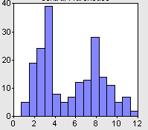
Selecting a Threshold
Bimodal Histogram
Threshold

Slide 8
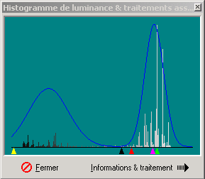
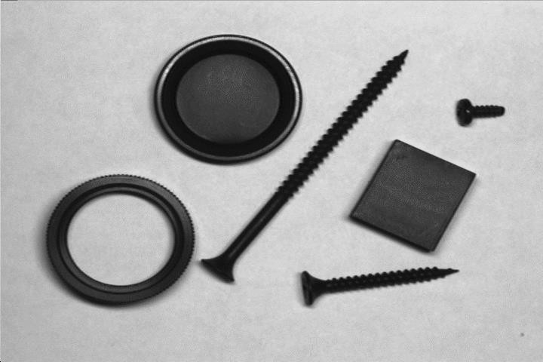
Selecting a Threshold
Objects
Set threshold
here

Slide 9

Binary Image
Problem here
How do we fill “missing pixels”?

Slide 10
Mathematic Morphology
◆ used to extract image components that are useful in the representation and description of region shape, such as…
◆ boundaries extraction
◆ skeletons
◆ convex hull
◆ morphological filtering
◆ thinning
◆ pruning
11

Slide 11
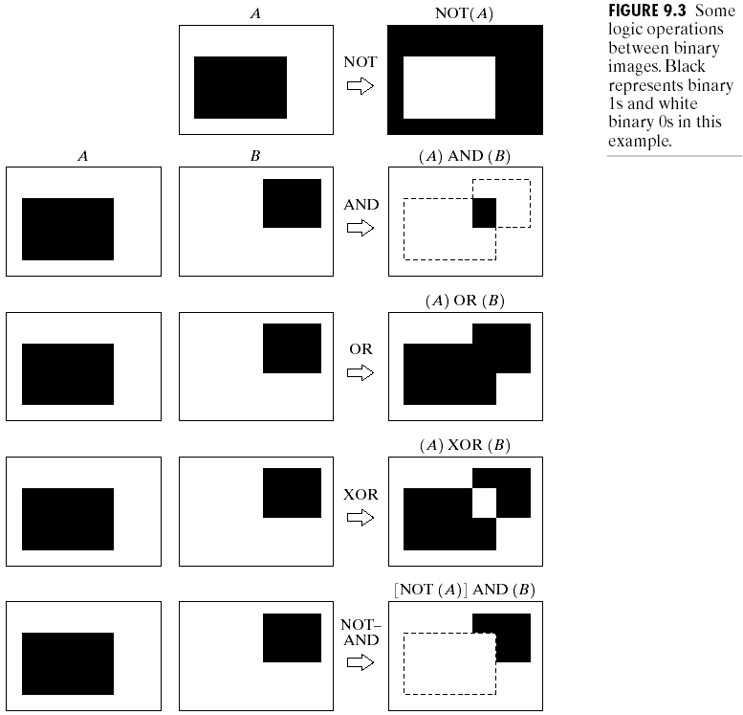
Example
17

Slide 12

Structuring element (SE)
small set to probe the image under study
for each SE, define origo
shape and size must be adapted to geometric properties for the objects
12

Slide 13
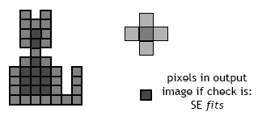
Basic idea
◆ in parallel for each pixel in binary image:
◆ check if SE is ”satisfied”
◆ output pixel is set to 0 or 1 depending on used operation
13

Slide 14
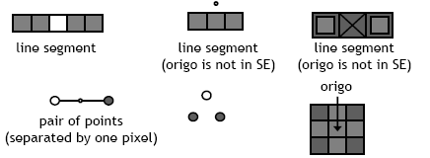
How to describe SE
◆ many different ways!
◆ information needed:
◆ position of origo for SE
◆ positions of elements belonging to SE
14

Slide 15

Basic morphological operations
◆ Erosion
◆ Dilation
15

Slide 16
Erosion
◆ Does the structuring element fit the set?
erosion of a set A by structuring element B: all z in A such that B is in A when origin of B=z
shrink the object
16

Slide 17
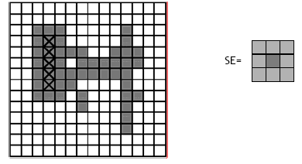
Erosion
17

Slide 18
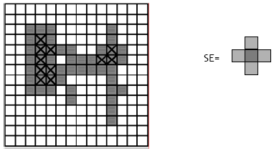
Erosion
18

Slide 19
Dilation
◆ Does the structuring element hit the set?
◆ dilation of a set A by structuring element B: all z in A such that B hits A when origin of B=z
◆ grow the object

Slide 20
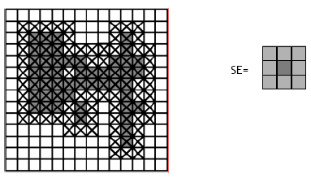
Dilation

Slide 21
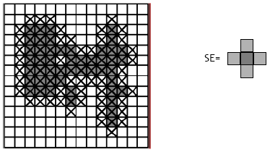
Dilation

Slide 22
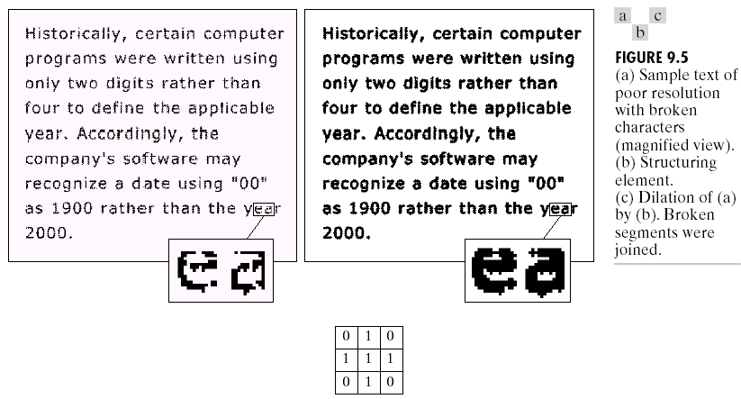
Dilation : Bridging gaps

Slide 23
Why useful?
Erosion
removal of structures of certain shape and size.
Dilation
filling of holes of certain shape and size.

Slide 24
Combining erosion and dilation
◆ WANTED:
◆ remove structures / fill holes
◆ without affecting remaining parts
◆ SOLUTION:
◆ combine erosion and dilation
◆ (using same SE)

Slide 25
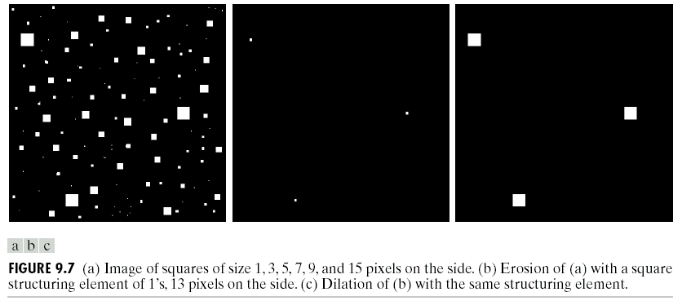
Erosion : eliminating irrelevant detail
structuring element B = 13x13 pixels of gray level 1
level 1

Slide 26
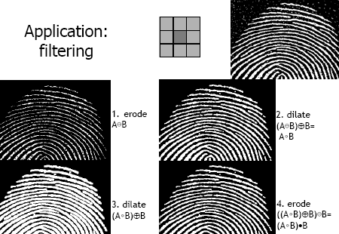
Application: filtering

Slide 27
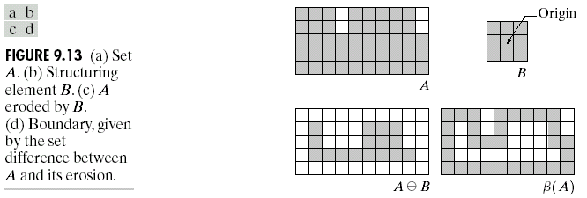
Boundary Extraction
β (A) = A −(A − B)

Slide 28
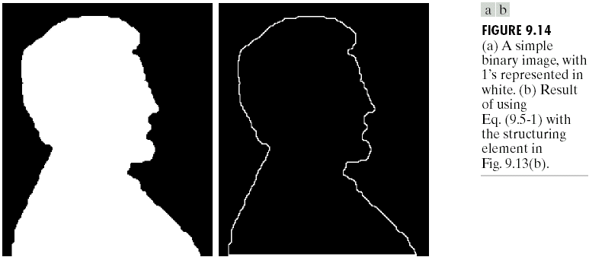
Example

Slide 29
Questions?

